Slide 1
EC2 Demo
Installing WordPress on an EC2 instance
We will use EC2, install MariaDB, Apache and libraries and then download WordPress.

Slide 2
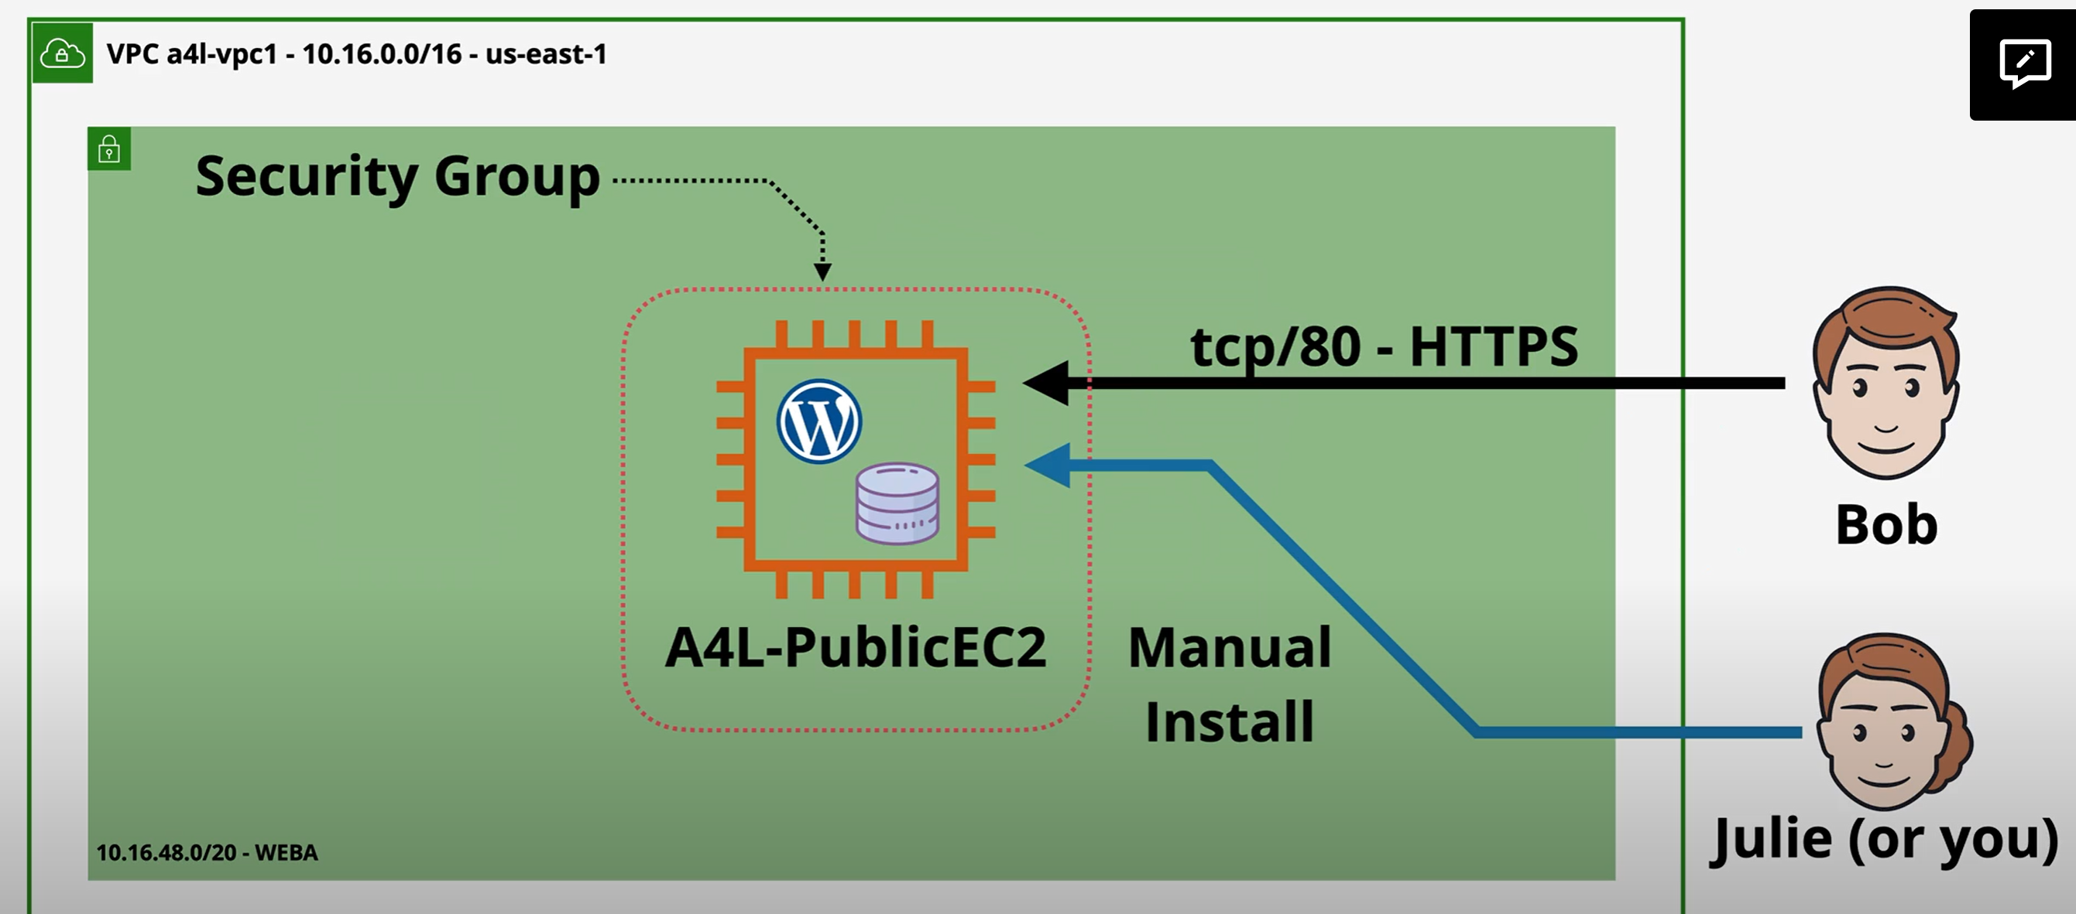
EC2 Demo

Slide 3
EC2 Demo
.

Slide 4
EC2 Demo
.

Slide 5
EC2 Demo
.

Slide 6
EC2 Demo
.

Slide 7
EC2 Demo
.

Slide 8
EC2 Demo
.

